Slide 1
Exam 4: Bodies
Chapters 9, 10, & 11
Rotation, Equilibrium, Stress & Strain

Slide 2
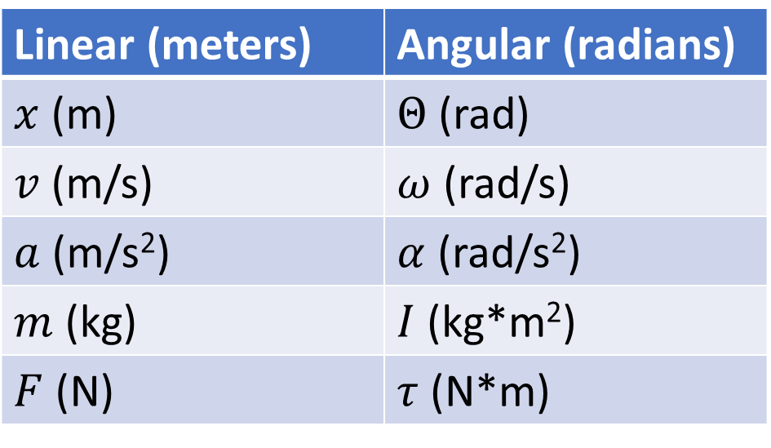
Chapter 9 – Angular Coordinates
Linear (meters) | Angular (radians)
$x$ (m) | $Θ$ (rad)
$v$ (m/s) | $ω$ (rad/s)
$a$ (m/s²) | $α$ (rad/s²)
$m$ (kg) | $I$ (kg*m²)
$F$ (N) | $τ$ (N*m)

Slide 3
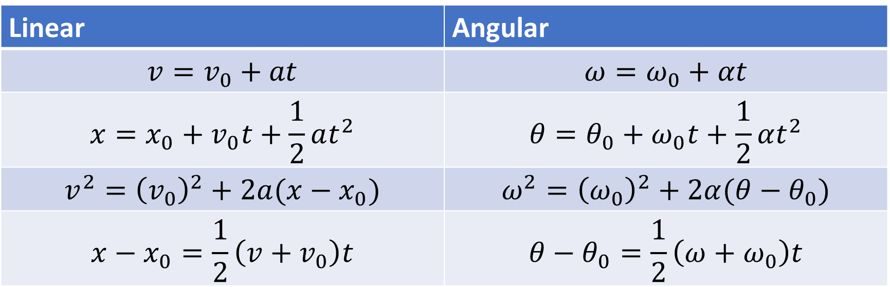
Chapter 9 – Angular Kinematics
Linear | Angular
$$v=v_{0}+at$$ | $$ω=ω_{0}+αt$$
$$x=x_{0}+v_{0}t+\frac{1}{2}at^{2}$$ | $$θ=θ_{0}+ω_{0}t+\frac{1}{2}αt^{2}$$
$$v^{2}={\left(v_{0}\right)}^{2}+2a(x−x_{0})$$ | $$ω^{2}={\left(ω_{0}\right)}^{2}+2α(θ−θ_{0})$$
$$x−x_{0}=\frac{1}{2}\left(v+v_{0}\right)t$$ | $$θ−θ_{0}=\frac{1}{2}\left(ω+ω_{0}\right)t$$

Slide 4

Chapter 9 – Converting Between Linear and Angular
$v=rω$
$a_{tan}=rα$
$a_{rad}=\frac{v^{2}}{r}=rω^{2}$

Slide 5
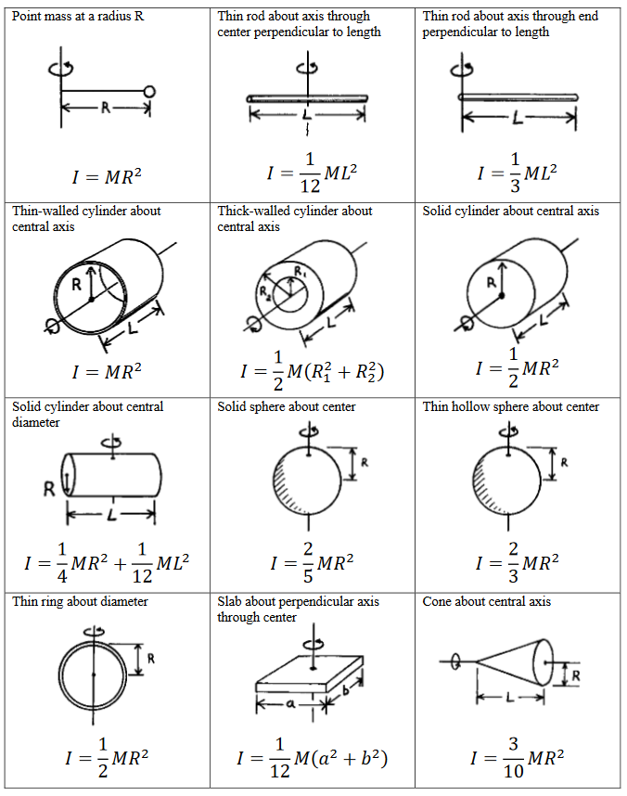

Chapter 9: Moment of Inertia
$I=m_{1}r_{1}^{2}+m_{2}r_{2}^{2}+ . . .$
Parallel axis theorem: $I_{p}=I_{cm}+md^{2}$

Slide 6
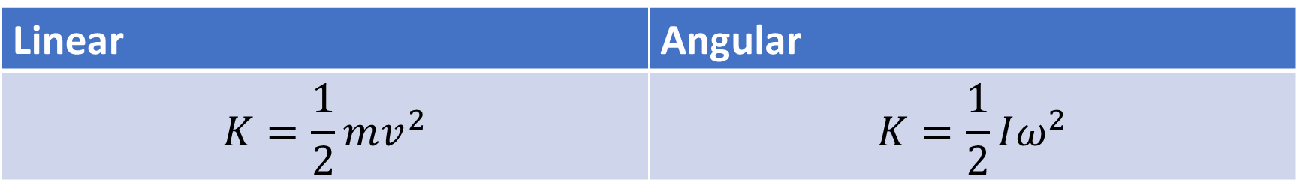
Chapter 9 – Rotational Kinetic Energy
Linear | Angular
$$K=\frac{1}{2}mv^{2}$$ | $$K=\frac{1}{2}Iω^{2}$$

Slide 7
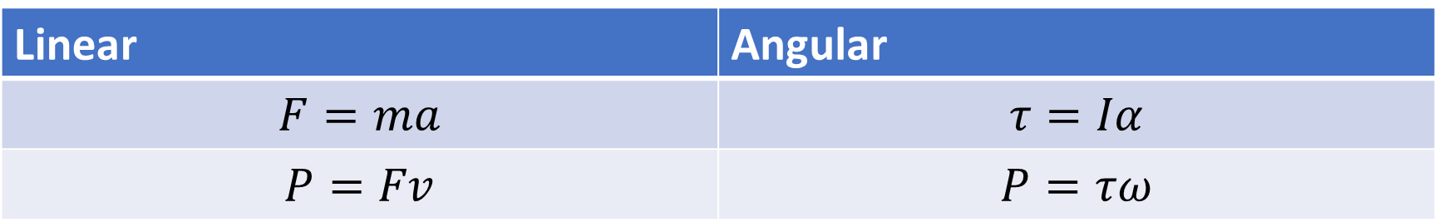

Chapter 10 - Torque
Torque = Force * LeverArm
$\overset{⃑}{τ}=\overset{⃑}{r}×\overset{⃑}{F}$
Linear | Angular
$$F=ma$$ | $$τ=Iα$$
$$P=Fv$$ | $$P=τω$$

Slide 8
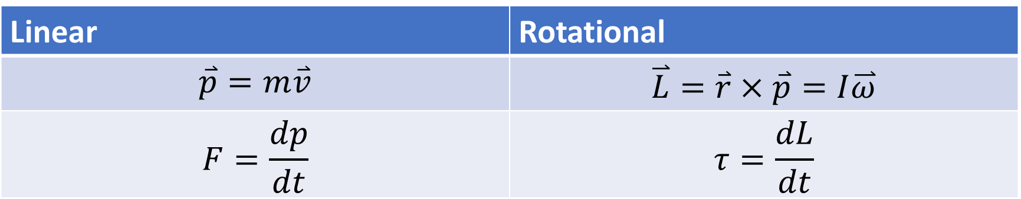
Chapter 10 – Angular Momentum
Linear | Rotational
$$\overset{⃑}{p}=m\overset{⃑}{v}$$ | $$\overset{⃑}{L}=\overset{⃑}{r}×\overset{⃑}{p}=I\overset{⃑}{ω}$$
$$F=\frac{dp}{dt}$$ | $$τ=\frac{dL}{dt}$$

Slide 9
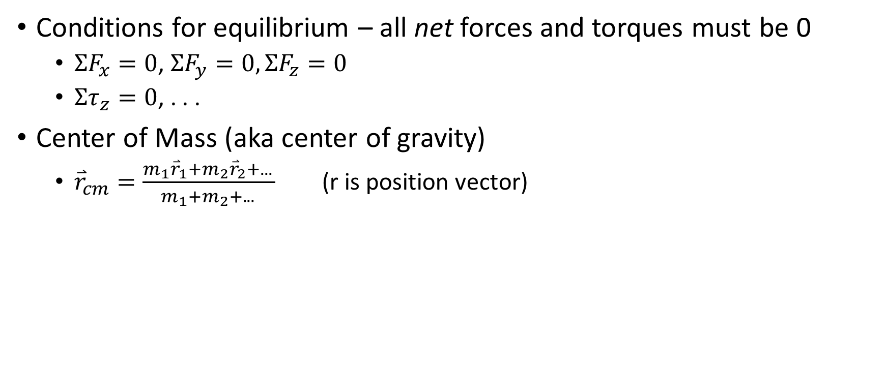
Chapter 11 – Equilibrium
Conditions for equilibrium – all net forces and torques must be 0
$ΣF_{x}=0$, $ΣF_{y}=0,ΣF_{z}=0$
$Στ_{z}=0$, . . .
Center of Mass (aka center of gravity)
${\overset{⃑}{r}}_{cm}=\frac{m_{1}{\overset{⃑}{r}}_{1}+m_{2}{\overset{⃑}{r}}_{2}+. . . }{m_{1}+m_{2}+. . . }$ (r is position vector)

Slide 10
Chapter 11 – Stress and Strain
Stress = Pressure = Force/Area
Strain = Deformation = change in length / original length
Elastic Modulus = Stress/Strain

Slide 11
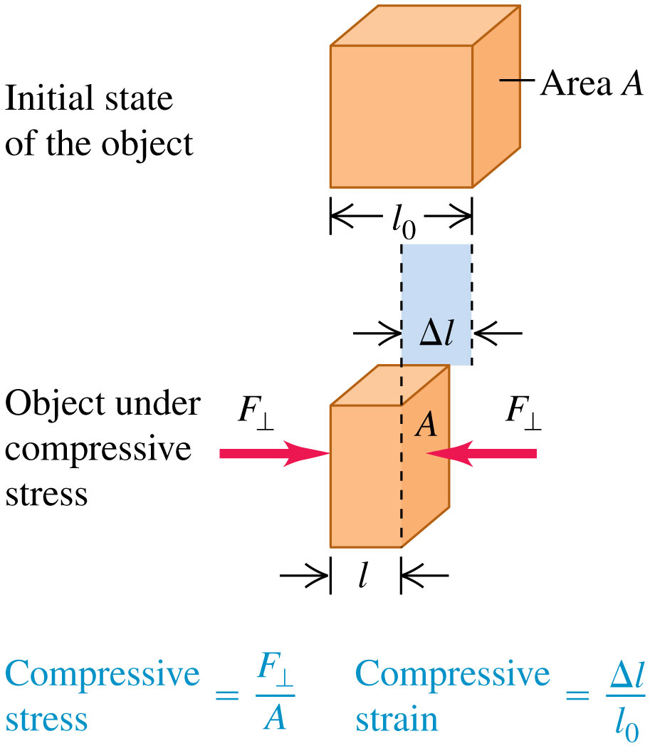
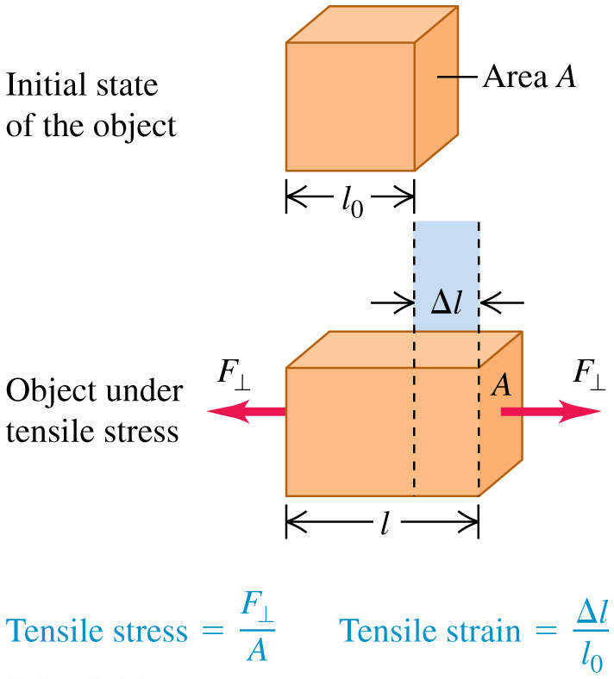
Tensile Stress and Strain

Slide 12
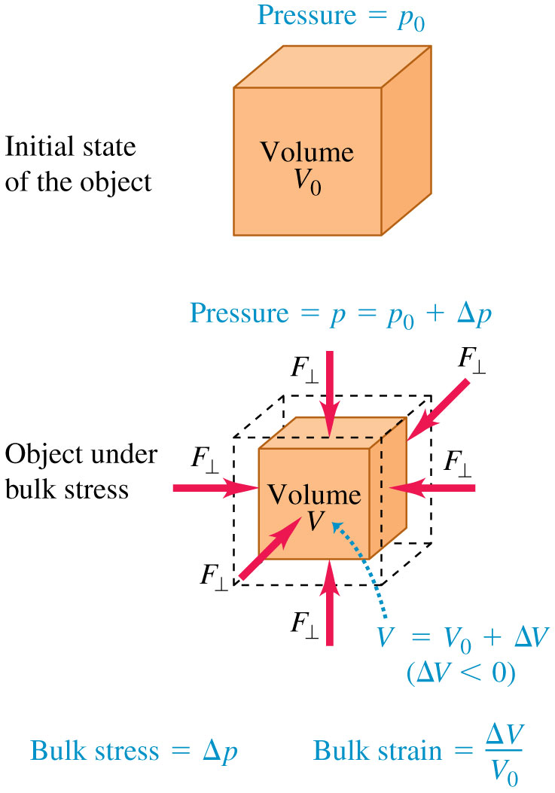
Chapter 11 – Bulk Stress and Strain
Bulk is from all sides (ie volume)
Bulk stress = change in pressure
Bulk strain = change in volume / original volume
Bulk modulus is still stress / strain

Slide 13
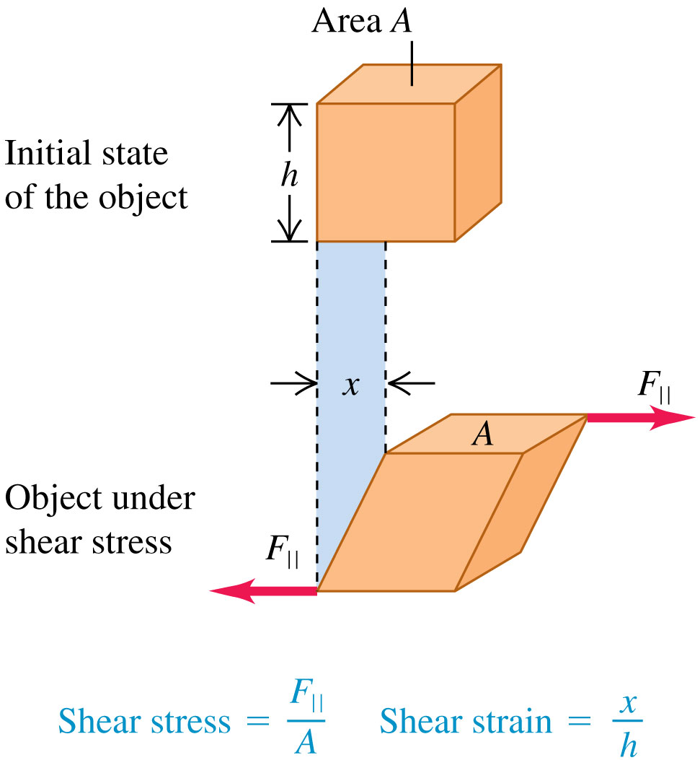
Chapter 11 – Sheer Stress and Strain
Stress = F / A
Strain = x / h

Slide 14
A cylinder rotates with a constant angular speed of 120 rpm. At time t=0s, the disk’s rotational axis begins to experience a constant friction, which causes an angular acceleration of 0.3 rad/s².
What is the angular speed of the disk at t=15 s? (8.0664 rad/s)
How long does it take the disk to come to a stop? (41.888 s)
How many revolutions does the disk make before it comes to a stop? (41 revolutions)
How long does it take the disk to complete 10 revolutions? (17.1067 s)

Slide 15
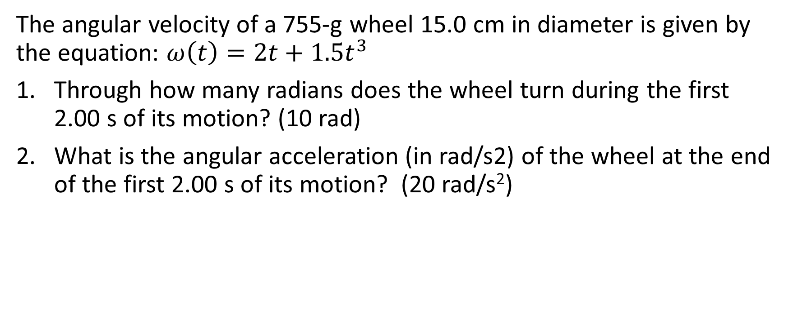
The angular velocity of a 755-g wheel 15.0 cm in diameter is given by the equation: $ω\left(t\right)=2t+1.5t^{3}$
Through how many radians does the wheel turn during the first 2.00 s of its motion? (10 rad)
What is the angular acceleration (in rad/s2) of the wheel at the end of the first 2.00 s of its motion? (20 rad/s²)

Slide 16
Two blocks are connected by a massless rope and hung over a frictionless pulley in the shape of a solid cylinder. There is no slipping between the cord and the surface of the pulley. The blocks have mass of 3.0 kg and 5.7 kg, and the pulley has a radius of 0.12m and a mass of 10.3 kg. At the instant the 5.7 kg mass has fallen 1.5 m starting from rest
Find the speed of each block. (2.39 m/s)
Find the acceleration of the pulley (4.37 m/s²)
Find the kinetic energy of the pulley (14.76 J)

Slide 17
Two blocks are connected by a massless string wrapped over a pulley. The pulley has a mass of 5 kg and a radius of 2 m. One block with mass 10kg rests on a frictionless inclined plane which makes an angle of 30 degrees with the horizontal, while the other with a mass of 11 kg hangs over the edge of the plane.
Find the acceleration of the blocks (7.87 m/s²)
Find the torque acting on the pulley (39.35 N*m)

Slide 18
A thin rod with mass 100kg length 5 meters is fixed at one end of its length to a hinge joint with a vertical axis (meaning it is able to rotate in the horizontal plane about that end without friction). The free end of the rod is struck by a 10 kg magnet, which sticks to the tip of the beam, travelling at 50 m/s.
What is the angular velocity of the beam after impact? (2.31 rad/s)

Slide 19
A man holds a 2 m long, 10 kg bar with one hand placed at the left end of the bar, and the other placed 0.5 m from the left end.
Find the magnitudes and directions of the forces his hands exert on the bar (-98 N, 196 N)
If three 20 kg weights are added to the left end of the bar, such that the first weight is at the end, the second is 0.33 m from the end, and the third is 0.66 m from the end, assuming he keeps his hands in the same place,
Find the magnitudes and directions of the forces his hands exert on the bar

Slide 20
If a light cable with a diameter of 1 cm has an elastic modulus of 100,000 Mpa, and is fixed at one end to a ceiling while a 1000 kg weight hangs from the other end, find the strain in the cable. (.0012 m)

